Slide 1
Project Title: Okoloma Helipad Resurfacing
Charter Template
Business Case/ Objectives:
The purpose of this CAPEX driven project is to ensure proper drain off of surface water from the helipad especially during the rainy season thus improving its lifespan and ultimately restoring and maintaining its integrity. Improper water drain off from the helipad surface has been identified as the main cause of damaged helipad surface signage which is critical for signaling. This has been a recurring finding during annual helipad audits. Resurfacing and repainting the helipad will address the findings.
Potential Benefits & Measurement:
Assure Integrity of the Helipad
Improve asset lifespan
Assure Emergency Response Preparedness
Project Scope/Actions :
Secure Management approval
Site Assessment Report Issued
Draft scope of work ready
CMT Appointed
Contracting strategy agreed
Cost estimates ready
Part A approved
ITT issued
Contract Awarded
Kick-off meeting held
Pre-mob/ Mob vendor
Demolition
Site installation.
Handover
Vendor Demobilized
Critical Success Factors:
Community FTO
Asset Leadership/Stakeholder Support
Project Sponsor: Florence / Ikechukwu
Implementation Lead: Ebere Onoh
Project Team:
Oluwasegun Ajagbe
High-level Timeline:
L0-L1: May 2018
L2: May 2018
L3: Aug. 2018
L4: Aug. 2018
L5: 30 Oct. 2018
Initiative End (30 Oct. 2018)

Slide 2
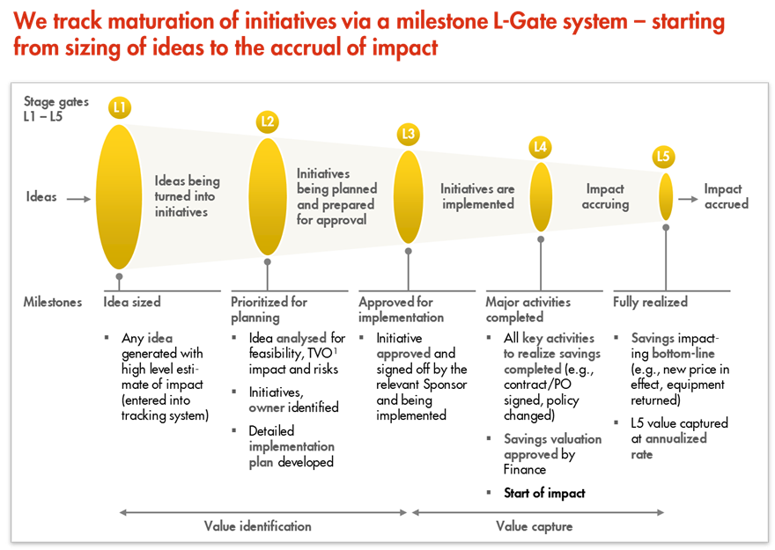
L1 – L5 Gates

